Slide 1

Moviatrafik Mobility for Lunch:
Latest Experiences with the Deutschland-Ticket
23 April 2026, 12:00 – 12:45 h
Ulrich Weber, VDV

Slide 2
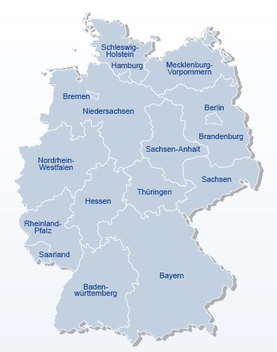
Key facts about the German regional and local Public Transport
The Länder/states are in charge of regional public transport (rail services)
The Federal Government provides subsidies for regional public transport (rail-services) and for infrastructure investments.
The counties and municipalities are in charge of local public transport (bus/tram/metro)
The counties and municipalities often own their local public transport company

Slide 3
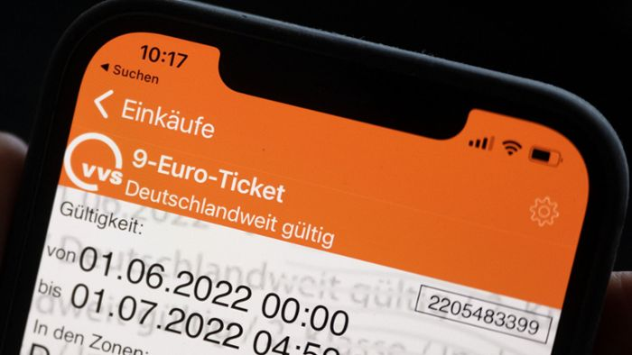
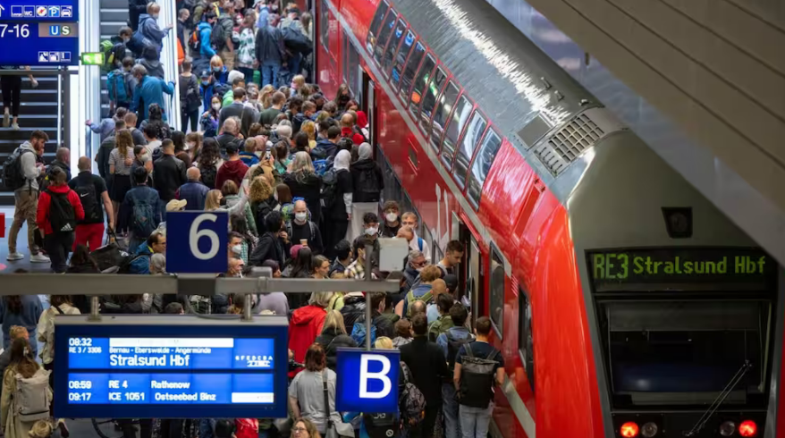
From the 9-Euro ticket in 2022 to the Deutschland-Ticket in 2023
1st requirement: Climate protection
  Climate damages increase, goal:
  Germany to be climate-neutral by 2045
  2nd requirement: Price increase protection
  Russian aggression towards Ukraine leads to price increases in electricity, gas, fuel
  Lower the burden of households regarding mobility costs
  Experiment: The 9-Euro-Ticket
  from June 1 to August 31, 2022
  monthly pass for public transportation, valid nationwide, 52 million tickets sold
  The conclusion: One ticket for everything
  Success factors: 1. affordable price,
  2. nationwide validity

Slide 4
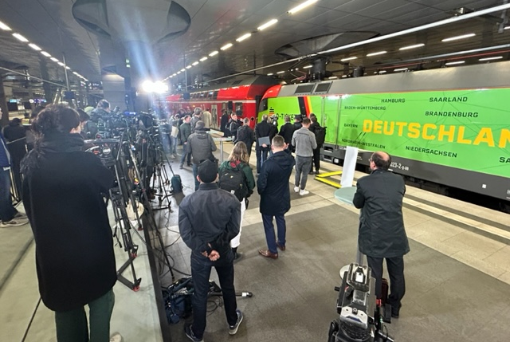
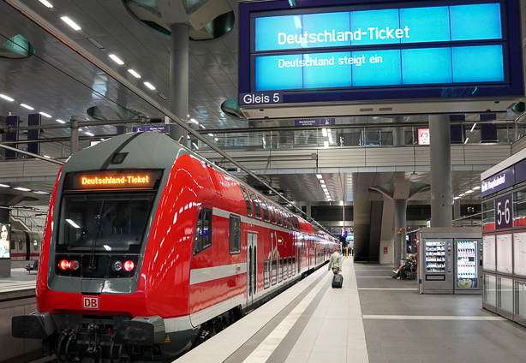
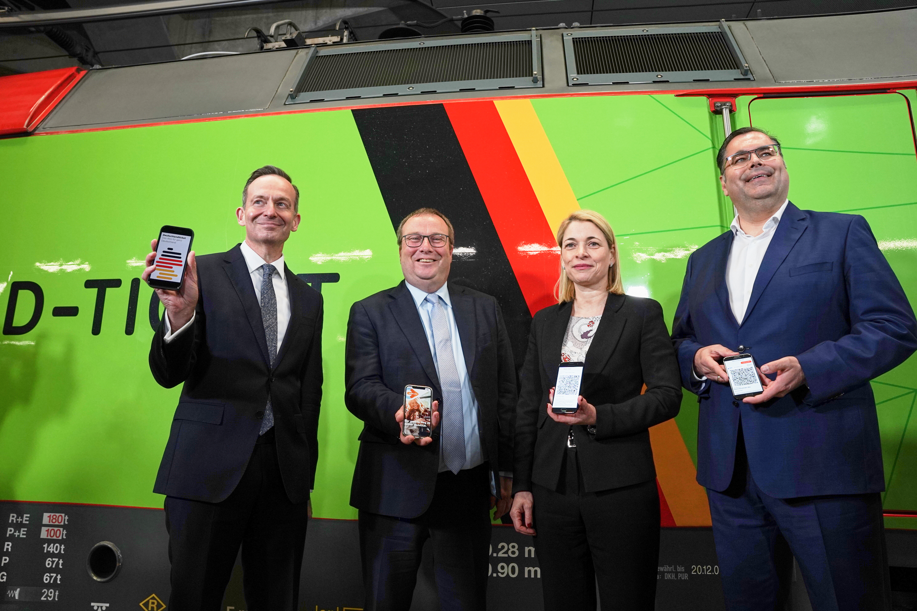
May 1, 2023: Launch of the Deutschland-Ticket
The Deutschland-Ticket („D-Ticket“)
49€ per month (D-Ticket Job 34,30€)
Since 1st May 2023
Coverage: entire German public transport network, excluding long-distance travel by bus or train
Monthly terminable subscription, non-transferable
No accompanying persons allowed, except for children under the age of 7
Reduced prize for students/pupils
Digital distribution: app/barcode or chip card,
no paper tickets from 1st January 2024
D-Ticket Ulrich Weber, Moviatrafik

Slide 5
Evolution of D-Ticket subscriptions (in million)
Monthly ticket prize evolution
49 EUR
58 EUR
63 EUR
Source: VDV

Slide 6
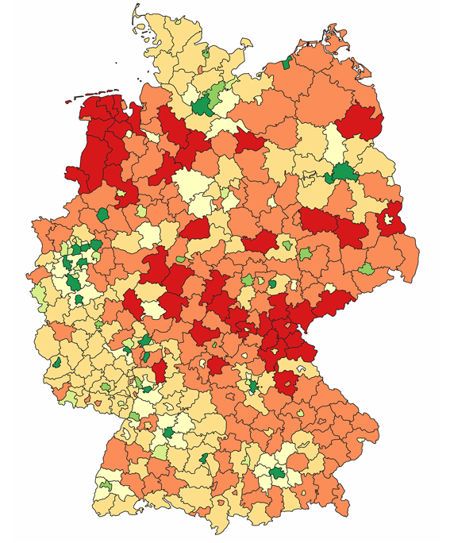
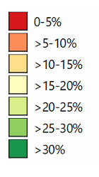
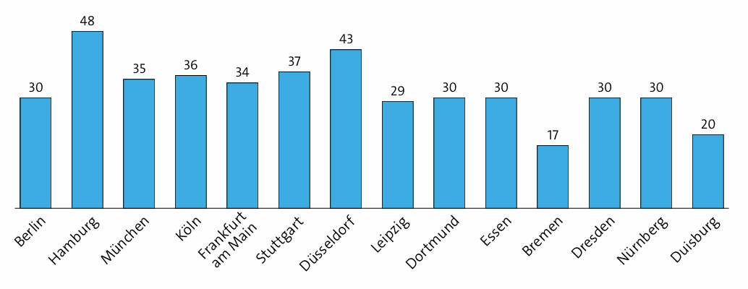
Regional market penetration of D-Ticket
D-Ticket holders:
Percentage of population
Larger German cities > 500.000 population
Source: INFAS D-Ticket evaluation report April 2026

Slide 7
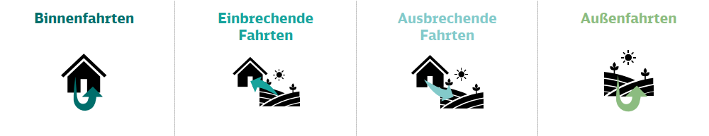
Large share of D-Ticket rides are within city/region
within city/region
Outside city/region
Incoming
Outgoing
D-Ticket users
85,1 %
3,6 %
3,8 %
7,6 %
Source: VDV/DB DT evaluation report Sept 2025

Slide 8
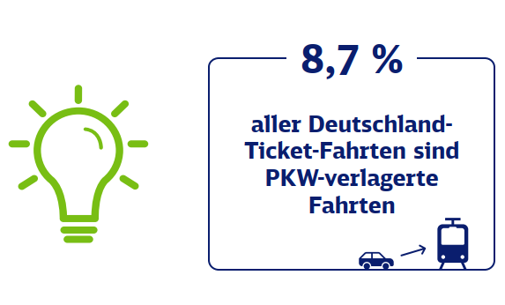
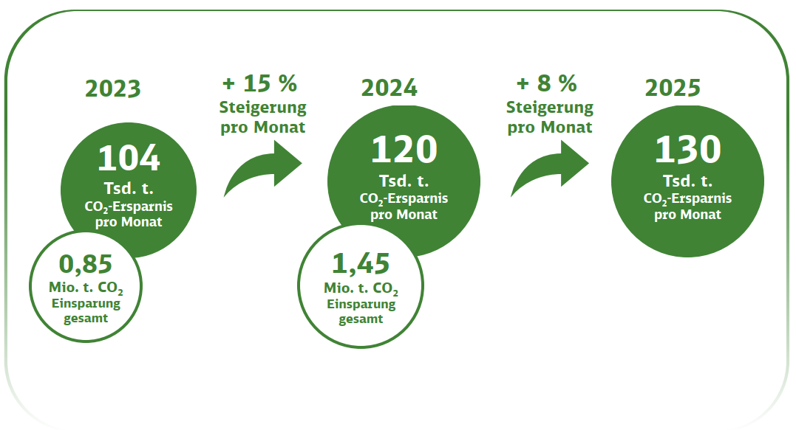
Modal shift/CO2 reduction resulting from D-Ticket
Modal shift:
CO2 reduction:
of all DT-rides shifted from car traffic
Source: VDV/DB DT evaluation report Sept 2025

Slide 9

Deutschland-Ticket: Current challenges (1)
The goals
Lower citizens’ burden from increased energy prices
Making public transportation more attractive for the people
Climate protection goals
The framework
D-Ticket could be “saved” over federal government change in 2025
Revenue compensation: €3 billion p.a., split equally between the federal government and the federal states
Transformation of sector has been pushed: Public transport sector organizes nationwide revenue sharing system + only digital tickets
German-wide ticket validity and simplicity as well as prize are given as the most important reasons from customers to buy D-ticket
But: Joint accompanying market research has been cancelled by federal government
VDV: “Nach dem D-Ticket brauchen wir ein D-Angebot/After the D-Ticket we need a D-Public transport offer”
long-lasting success of D-Ticket can only be achieved with a considerable increase of PT offer and quality
Substantial financial problems of cities/municipalities currently → PT offer is being reduced!
D-Ticket Ulrich Weber, Moviatrafik

Slide 10
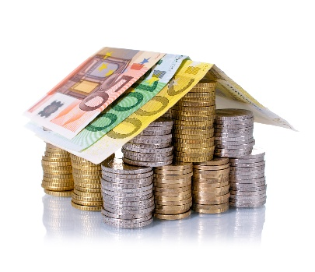
Deutschland-Ticket: Current Challenges (2)
The financial framework – now relative long-term stability
Federal government:
1,5 billion EUR annually
+
Federal states:
1,5 billion EUR annually
Decisions in Nov 2025 to have long-term funding of 3 billion EUR annually until 2030 → very important for communication towards customers incl. companies
However: fixed amount, no increase!
Annual prize increase to be decided with operational cost index agreed between Federal government, states and PT sector in March 2026.
PT production cost increase/inflation has to be fully covered by passengers!
Instead of increasing compensation for DT or investing more in PT offer, the Federal government has decided to give a fossil fuel prize discount to car drivers!
D-Ticket Ulrich Weber, Moviatrafik

Slide 11

Deutschland-Ticket: Compensation/Revenue sharing and ensuring revenues
Organisation of Germany-wide revenue sharing concept:
D-TIX organisation
All D-Ticket sellers have a contract with D-Tix
→ precondition for financial compensation
Revenue sharing currently based on post codes of D-Ticket holders
Discussions on further revenue sharing concept based on automatic passenger counting system/APC or other technology (not before 2030?)
Compensation based on ex-ante applications (based on previous year) of PTAs and ex-post financial billing
Ticket Fraud: false tickets offered on internet/ebay below regular prize
  Considerable efforts to improve ticket security also for UIC barcode standard comparable to already higher security standards implemented with VDV E-ticket: signature keys, nation-wide “black lists” etc.
D-Ticket Ulrich Weber, Moviatrafik

Slide 12
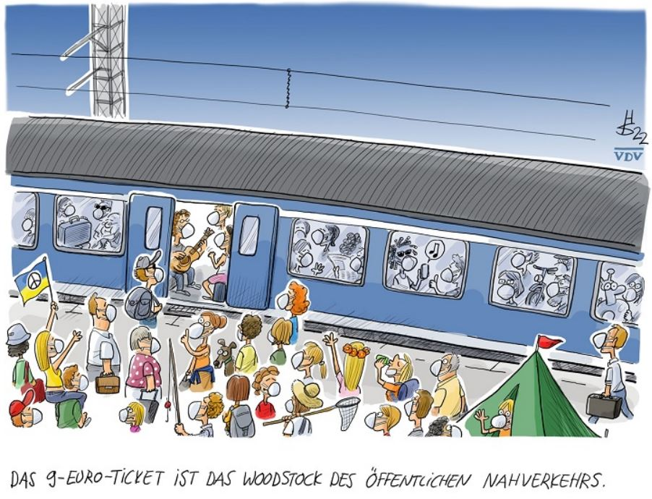
Thank you very much – Time for Questions
Contact: weber@vdv.de

